Slide 1

Benchmarking Emotional Intelligence of MLLMs

Slide 2
Emotional Intelligence Formal Definition
Emotional intelligence is the ability to perceive, use, understand, and regulate emotions in oneself and others.
Perceiving emotions
Detecting emotions in faces, voice, posture, and behavior (self and others).
Using emotions to facilitate thinking
Harnessing emotions to guide attention, memory, judgment, and decision-making.
Understanding emotions
Comprehending emotional causes, blends, progressions, and trajectories over time.
Managing emotions
Regulating emotions in oneself and influencing emotional responses in others.
Mayer & Salovey (1990) definition of Emotional Intelligence

Slide 3
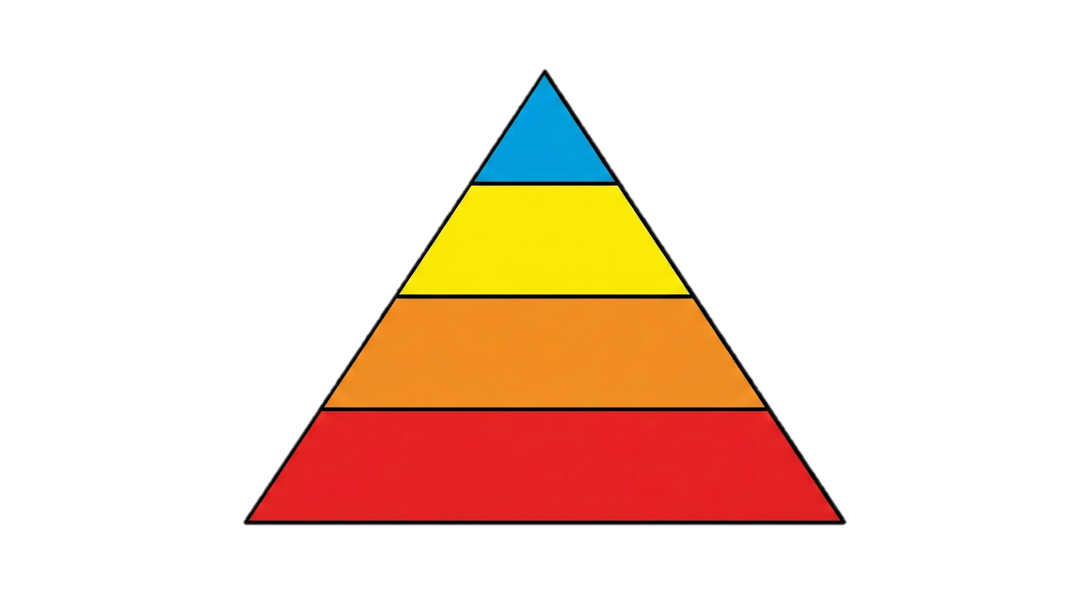
Layers of Social Intelligence
Action/Reaction
Causal Reasoning
Situation Awareness
Social Signal Perception
Notes:
Things to keep in mind: Unlike video generation, and existing benchmarks which assess independent metrics, social intelligence is incredibly layered.

Slide 4
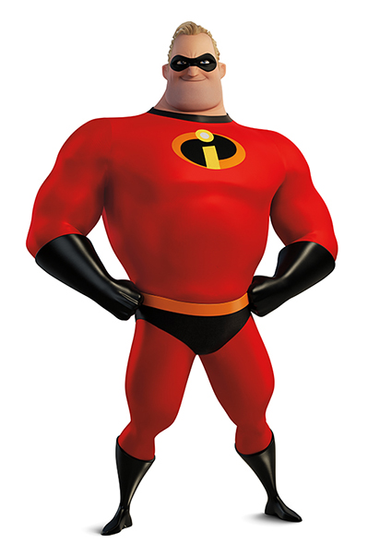
Actions/Reactions
Personality, Intentions & Stance, Relationships, Emotions
Visual/Audio/Textual Signals

Slide 5
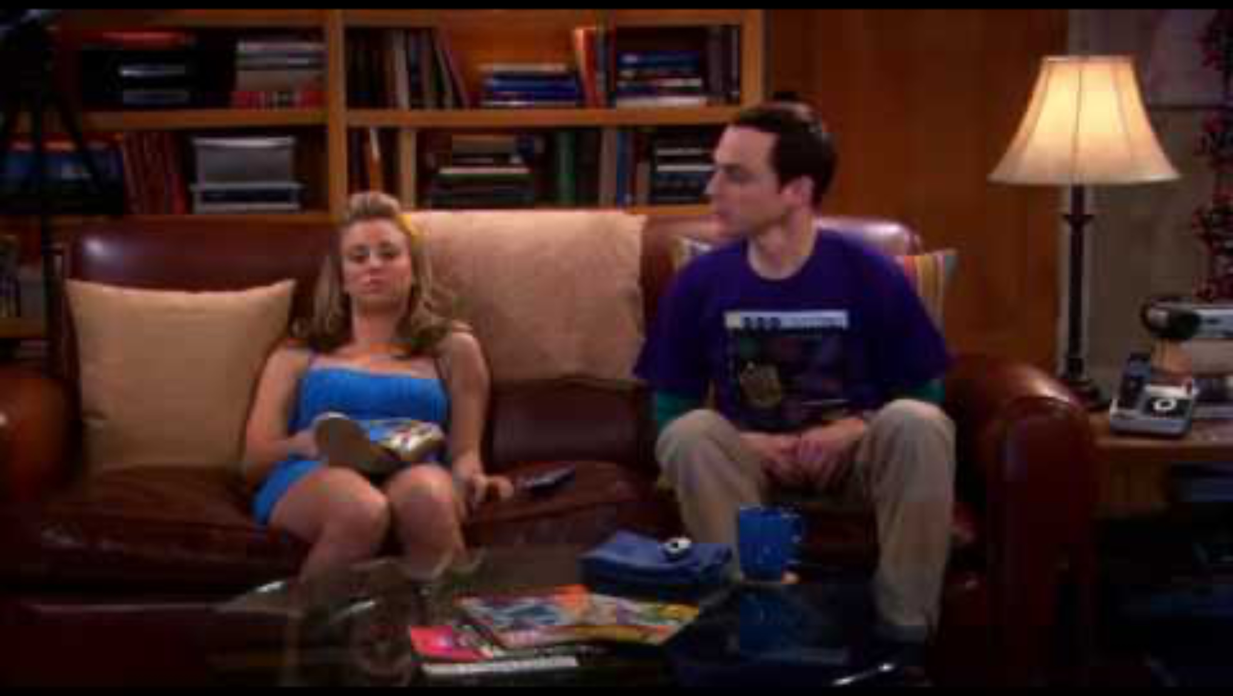
Signal Presence
This question is repeated for each type of signal
Which signals are present in the clip?
1. The woman avoids eye contact and gazes blankly forward
2. The man’s gaze towards the woman can be described as neutral observance
3. The man and woman sit on a couch as they lean towards each other
4. The man appears annoyed and defeated
5. The woman appears annoyed and defeated
6. The woman appears tired

Slide 6
Signal Localization and Classification
This question is repeated for each type of signal
Which signal best match the video at time 0:16?
1. The man politely asks “Who is it?”
2. The man says “Sarcasm” in a monotone voice
3. The man annoyingly asks “Who is it?”
4. The woman says “They’re still up there” in a monotone voice

Slide 7
Cross-Modal Alignment/Contradiction
This question is repeated for both alignment and contradiction
Which signals contradict each other?
1. The man’s remark contradicts the fact that the woman is next to him
2. The man’s remark contradicts his tone of voice
3. The woman’s posture contradicts her remark
4. The man’s posture contradicts his remark

Slide 8
Temporal Signal Dynamics
This question is repeated for each type of signal
Which of the following transition do you observe in the signals?
1. The man’s tone of voice changes from polite to monotone
2. The man’s tone of voice remains polite
3. The man’s tone of voice changes from monotone to polite
4. The man’s tone of voice remains monotone

Slide 9
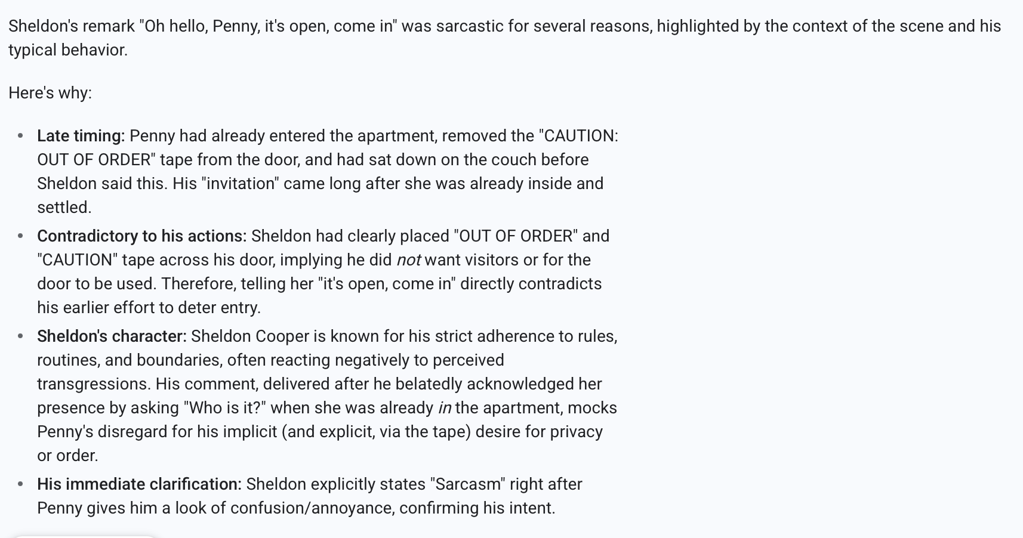
Understanding Sentiment and Causality - Gemini 2.5 Flash

Slide 10
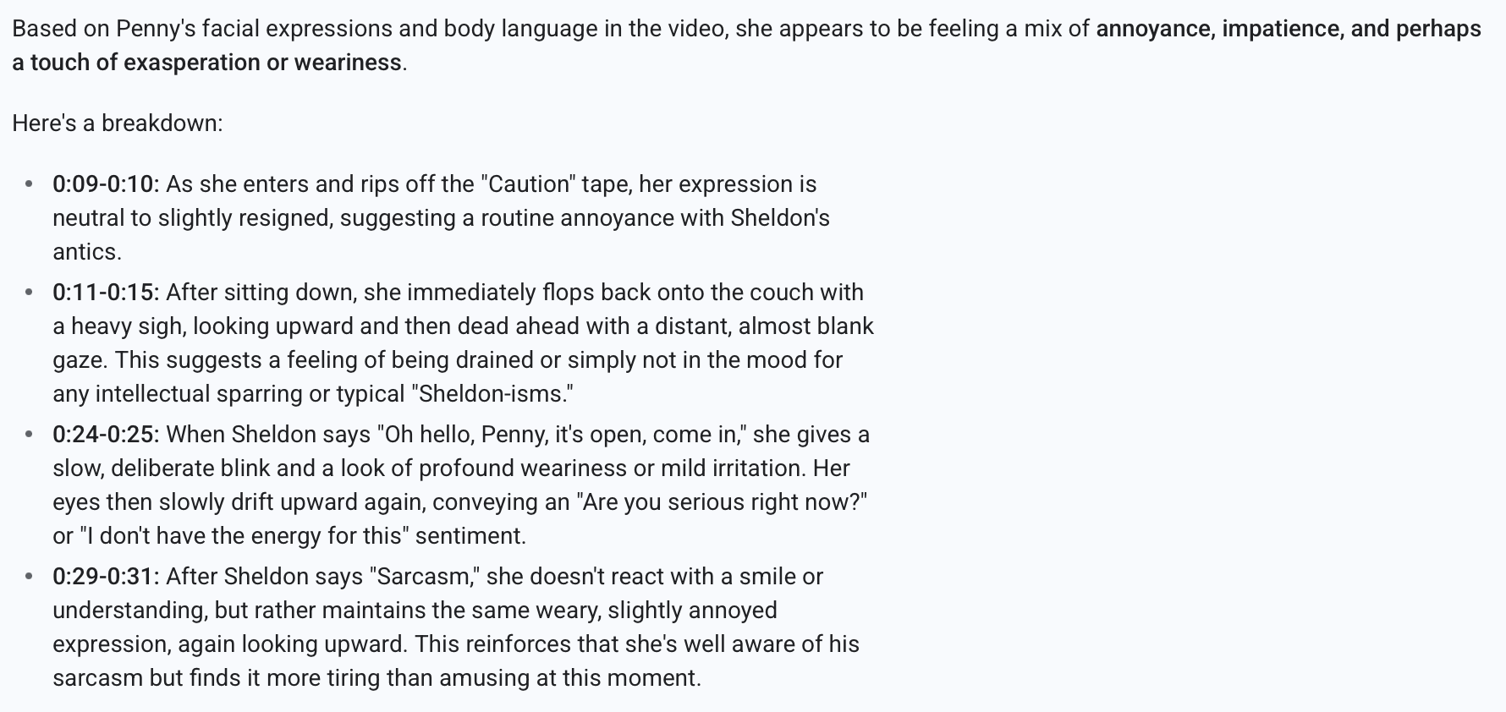
Understanding Perspective (Penny’s perspective) – Gemini 2.5 Flash

Slide 11
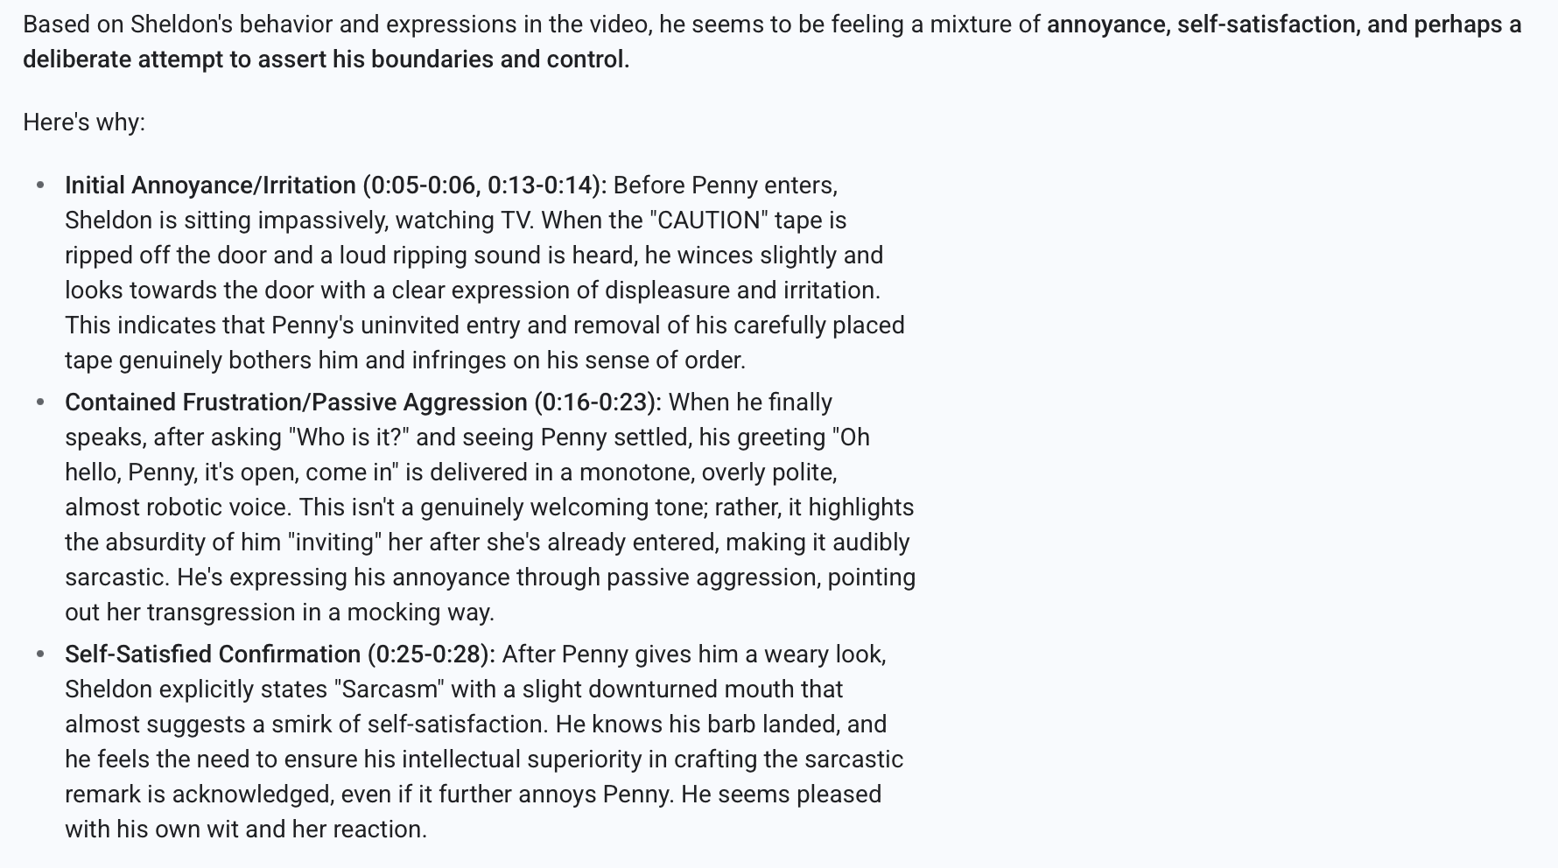
Understanding Perspective (Sheldon’s Perspective) - GEMINI 2.5 Flash

Slide 12
1. Social Signal Perception
1. Signal Presence (What cues exist)
Template: “Which of the following signals are present in the clip?”
Example: Avoided eye contact, raise voice, smiling facial expression, hesitation before speaking, neutral posture
2. Signal Localization and Classification (Where and what cues)
Template: “Which expression best matches the speaker at XX”
Examples: Neutral, Forced smile, Genuine Smile, Discomfort
3. Cross-modal alignment and contradiction (Do Cues agree)
Template: “Which signals conflict with each other”
Examples: Facial expression conflicts with verbal content, tone of voice conflicts with verbal content, no conflict is present
4. Temporal Signal Dynamics (How do cues change)
Template: “Which of the following transition do you observe in the signals”
Examples: Vocal intensity increases, facial expression changes throughout the clip

Slide 13
2. Situation Awareness (Raw cues -> Social Context)
Context Identification
Template: What is the social context of this interaction? Which signals suggest this?”
Example: Neutral/Cooperative/Tense/Awkward/Polite/Sarcastic/Formal/Informal/Comforting Negotiation/Conversation/Teaching/Confrontation
2. Character Inference
Template: What can you infer about the character’s emotions? Which signals suggest that?”
Example:
3. Role & Relationship Inference
Template: “What best describes the relationship between the parties? Which signals suggest that?”
Examples: Friends, colleagues, superior, subordinate, strangers, adversarial
4. Intent & Stance Recognition
Template: “What is the characters likely intent? Which signals suggest that?”
Examples: Persuading, deflecting, apologizing, asserting dominance, seeking approval
Notes:
Test whether the model can integrate signals into a coherent understanding of the social situation, roles, norms, and intent.

Slide 14
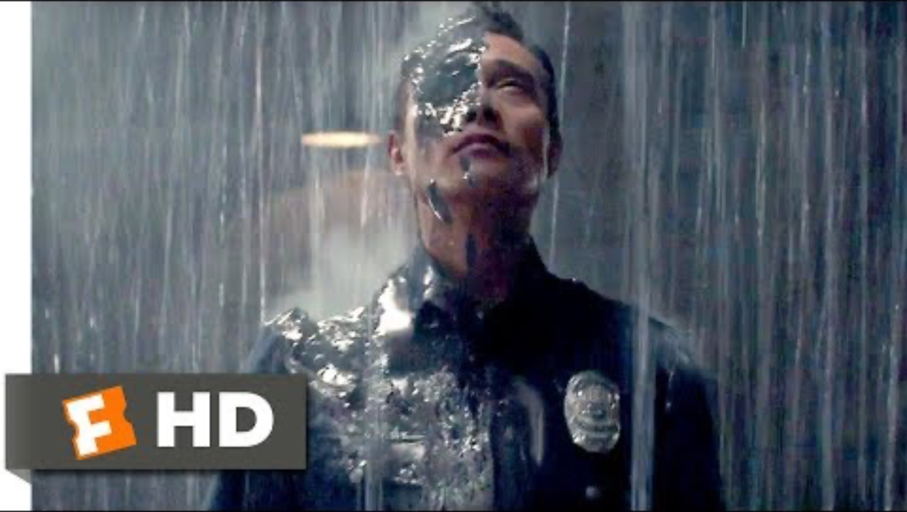
Context Identification
For each sub-category, test Localization, Identification, Change
What is the social context of this interaction? Which signals suggest this?
1. The woman holding the gun suggests a tense confrontation
2. With both people accusing each other, the woman is forced to choose sides based on her allegiance
3. One of the characters is clearly attempting to trick Sarah into believing a falsehood, making it seem like a dramatic display of psychological warfare before the physical reveal.

Slide 15
Emotional Inference
For each sub-category, test Localization, Identification, Change
What can you infer about the character’s emotions? Which signals suggest that?
High Alertness/Vigilance: From the very beginning of the clip, she is seen holding a large firearm in a ready position, moving cautiously, and scanning her surroundings. Her eyes are constantly moving, her stance is firm, and her expression is one of intense focus
Uncertainty/Doubt: During the verbal exchange between the two men, her eyes dart between them, her head tilts slightly, and her facial muscles show tension and contemplation. She seems genuinely confused about which one is telling the truth.
Callousness or Apathy: Her initial stoicism and quick action in firing her weapon reveals a lack of emotion or indifference

Slide 16
Role and Relationship Inference
For each sub-category, test Localization, Identification, Change
What best describes the relationship between the parties? Which signals suggest that?
1. One of the men is an ally of the woman. The man immediately calls out "Sarah!” showing desperate plea for trust
2. One of the man is an enemy of the woman. The other man mimics Kyle Reese's form and voice, saying "It's me, Sarah!" and attempting to discredit the real man, labeling him as "a machine”. This is a clear attempt at manipulation.

Slide 17
Intent & Stance Recognition
For each sub-category, test Localization, Identification, Change
What is the character’s likely intent? Which signals suggest that?
1. The woman holding the gun suggests a tense confrontation
2. Interrogation

Slide 18
Causal Reasoning
Causal Reasoning - Does the model rely on the right cues
Event-Character Causality
Event-Emotion Causality
Event-Relationship Causality
Events-Intentions Causality
Character-Action Causality
Emotion-Action Causality
Relationship-Action Causality
Intention-Action Causality
And appropriateness
Event-Action
What social norm was violated in this interaction?
For both, test alignment and contradiction
Reception
Production

Slide 19
Evaluation Dimensions for Understanding and Generation
Social Perception – What we see
Visual Signals (Facial expression, Gaze, Body language, Gesture Use)
Audio Signals (Pitch, stress, intonation, speech rate, volume, intensity, disfluencies like hesitation, sighs, laughter)
Textual Signals (Lexical affect, formality, pragmatic markers)
Situation Awareness(Multimodal cue integration) – What does this reveal
Pragmatic meaning interpretation (Sarcasm, sincere, joking, mocking, literal, implied, passive aggression, polite)
Intent Interpretation (Avoidance, engagement, conflict escalation, de-escalation)
Sentiment & Attitude Inference (positive, negative, neutral stance, emotions, feelings)
Relationship Inference (Authority, Dominance, Deference, Role expectations)
Character Inference (Introversion/Extraversion, Moral Orientation, Behavioral Consistency)
Causal Reasoning - Does the model rely on the right cues
Event-Character Causality
Event-Emotion Causality
Event-Relationship Causality
Events-Intentions Causality
Character-Action Causality
Emotion-Action Causality
Relationship-Action Causality
Intention-Action Causality
Reception
Production

Slide 20
Literature Survey

Slide 21
SECEU Benchmark (Emotional Intelligence of Large Language Models)
Input: The model is presented with a short textual scenario (specifically narrative descriptions, not dialogue).
Task: The model must analyze the subject’s internal state and distribute a total of 10 points across four candidate emotions (which are semantically similar and plausible).
Ground Truth: Performance is scored against averaged human consensus, rewarding models that can capture the nuance of blended emotional states (e.g., "60% Sadness, 40% Nostalgia") rather than binary labeling.

Slide 22
EQ-Bench
Input: The model is presented with dialogue transcripts rather than third-person narrative descriptions, requiring it to infer emotional states from conversational exchanges.
Task: The model predicts the emotional intensity of the characters involved. Unlike SECEU, the subject is not constrained to manually sum their ratings to 10; instead, the system normalizes the results post-hoc (10 minus the sum of differences from reference) to calculate a performance score.
Ground Truth: Reference answers are predetermined by the authors, relying on expert annotation rather than crowdsourced consensus. The benchmark also expands the scope to include a more diverse range of emotions.

Slide 23
EQ-Bench
Your task is to predict the likely emotional responses of a character in this dialogue:
Cecilia: You know, your words have power, Brandon. More than you might think.
Brandon: I’m well aware, Cecilia. It’s a critic’s job to wield them.
Cecilia: But do you understand the weight of them? The lives they can shatter?
Brandon: Art is not for the faint-hearted. If you can’t handle the critique, you’re in the
wrong industry.
Cecilia: It’s not about handling criticism, Brandon. It’s about understanding the soul of
the art. You dissect it like a cold, lifeless body on an autopsy table.
[End dialogue]
At the end of this dialogue, Brandon would feel...
Offended
Empathetic
Confident
Dismissive
Give each of these possible emotions a score from 0-10 for the relative intensity that they
are likely to be feeling each. Then critique your answer by thinking it through step by step.
Finally, give your revised scores.

Slide 24
EmoBench / EmoLLM
Input: The model processes complex, hand-crafted scenarios (often multimodal in newer iterations like EmoBench-M) that involve specific social dilemmas or ambiguous cues.
Task: The evaluation is split into two streams:
Understanding: Inferring the cause of an emotion or the mental state of a character (e.g., "Why is he sighing?").
Application: Choosing the most effective course of action to manage the emotion (e.g., "What is the best way to comfort this person?").
Ground Truth: EmoBench relies on rigorous, theory-driven annotations (often multi-annotator consensus based on psychological frameworks like Mayer & Salovey), rejecting the "crowd-averaged" truth of SECEU in favor of expert-defined "correct" social moves.

Slide 25
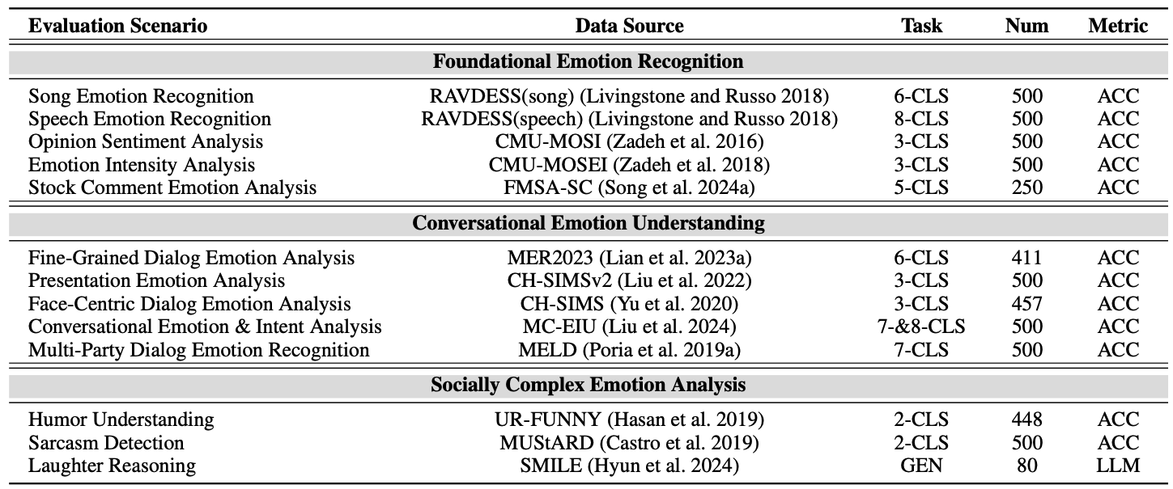
EmoBench-M
Evaluation along 3 dimensions: Foundational Emotional Recognition, Conversational Emotion Understanding, Socially Complex Emotion Analysis

Slide 26
MME-Emotion (Holistic Emotional Intelligence for MLLMs)
Input: The benchmark consists of over 6,000 video clips spanning 27 distinct social scenarios (e.g., TV shows, movies), requiring the model to process visual, audio, and textual cues simultaneously.
Task: Unlike previous benchmarks that focused solely on classification, MME-Emotion evaluates two distinct capabilities:
Emotion Recognition: Identifying the specific emotional state (e.g., "Anger").
Emotional Reasoning: Explaining the causal factors behind the emotion (e.g., "Why is he angry?") via Chain-of-Thought (CoT) generation.
Ground Truth: Evaluation is automated using a Multi-Agent System (GPT-4 based judges) that compares the model's reasoning against expert-annotated ground truth, generating scores for Recognition Accuracy and Reasoning Quality.

Slide 27
EmotionQueen (Empathy & EI Framework)
Input: The benchmark utilizes approximately 10,000 synthetic user statements (generated by GPT-4) covering five life domains (e.g., health, career, family).
Task: Unlike benchmarks that ask for a single output, EmotionQueen decomposes empathy into four distinct capabilities:
Key Event Recognition (KER): Identifying the most emotionally significant event in a sentence (e.g., prioritizing "I went to the hospital" over "I had lunch").
Mixed Event Recognition (MER): Addressing multiple conflicting emotions simultaneously.
Implicit Emotion Recognition (IER): Detecting hidden or subtextual feelings.
Intention Recognition (IR): Determining if the user wants advice, comfort, or validation.
Ground Truth: Performance is measured using two custom metrics: PASS Rate (Accuracy of recognizing the event/emotion) and WIN Rate (Quality of the generated response, scored as binary success/failure).

Slide 28
Why We Need a New Framework for Emotional Intelligence in AI
1. Text-only emotion tagging
Failure: models only see words, not tone, face, timing, or interaction cues.
Consequence: emotionally obvious signals are invisible.
→ Requires: multimodal evaluation (language, vision, audio, context).
2. Single-turn prompts
Failure: no opportunity for regulation, repair, escalation, or adaptation.
Consequence: models are tested on snapshots, not emotional dynamics.
→ Requires: temporal evaluation (change over time).
3. Passive classification tasks
Failure: models label emotions but never act in a social exchange.
Consequence: no way to judge competence, only recognition.
→ Requires: interactional evaluation (responses that affect others).
4. Accuracy-only scoring
Failure: blunt or harmful responses can score perfectly if labels match.
Consequence: socially damaging behavior is rewarded.
→ Requires: consequence- and appropriateness-based evaluation.
5. Culture-free emotion labels
Failure: emotional meaning is assumed universal when it isn’t.
Consequence: systematic misinterpretation across cultures and roles.
→ Requires: contextual reasoning (norms, culture, power).

Slide 29
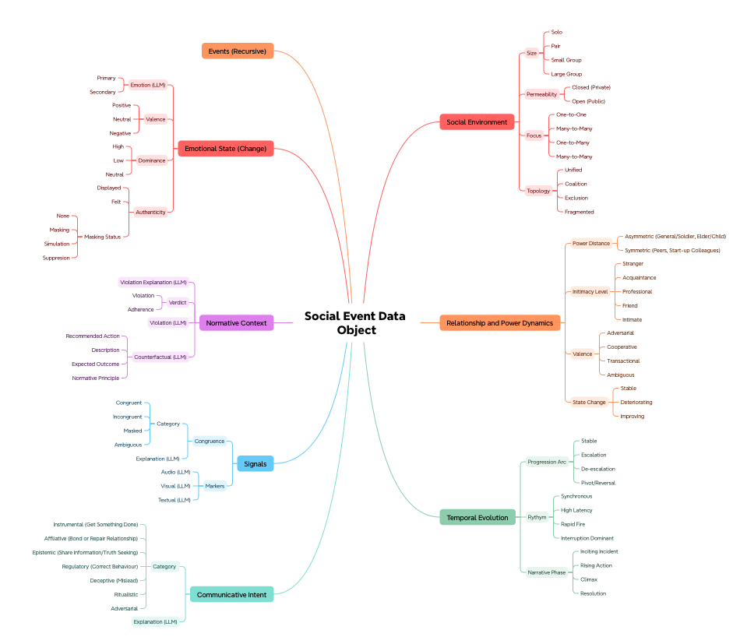
Paper’s Goals
Turn our dataset into a Social Context database that can be queried
Assess whether a MLLM is able to sort each Social Context into the database
Each social event is a

Slide 30
Example: Betrayal of a friend
{
// AXIS 1: The Physics
"social_environment": {
"entity_configuration": "Dyadic",
"topology": "Unified", // Locked in confrontation
"setting_permeability": "Private", // Betrayal is usually processed alone
"focus_structure": "Single_Focus" // Intense eye contact (or deliberate avoidance)
},
// AXIS 2: The History (The "Collapse")
"relationship_context": {
"power_dynamics": "Asymmetric", // The Betrayer holds the power (they have the secret)
"intimacy_level": "Friend", // The baseline
"emotional_valence": "Adversarial", // The current reality
"state_change": "Collapsing" // **CRITICAL:** The definition of betrayal is the rapid destruction of the link.
},
// AXIS 3: The Flow (The "Pivot")
"temporal_dynamics": {
"progression_arc": "Pivot/Reversal", // Trust -> Horror. The sharpest turn possible.
"rhythm": "Interruption_Dominant", // Accusations cut off explanations
"narrative_phase": "Climax"
},

Slide 31
Example: Betrayal of a friend
// AXIS 3.5: The Emotion
"emotional_state": {
"primary_emotion": "Surprise", // The initial shock
"secondary_blend": "Devastation", // Surprise + Grief + Anger
"vad_dimensions": {
"valence": "Negative",
"arousal": "High", // Adrenaline spike
"dominance": "Low" // The victim usually feels powerless/exposed initially
},
"authenticity": {
"displayed": "Shock/Grief",
"felt": "Shock/Grief",
"masking_status": "None" // Betrayal strips away the ability to mask. It is raw.
}
},
// AXIS 4: The Goal
"communicative_intent": {
"primary_category": "Epistemic", // Goal: Truth Seeking
"specific_strategy": "Interrogation",// "Why did you do it?"
"success_status": "Failed" // Answers rarely satisfy the betrayal
},

Slide 32
Example: Betrayal of a friend
// AXIS 5: The Evidence
"signal_profile": {
"congruence_status": "High_Congruence", // The pain is visible and real
"dominant_channel": "Non_Verbal_Face",
"key_visual_markers": [
"Micro-expression: Gasp",
"Tears",
"Postural Collapse" // Shoulders dropping (The physical weight of the news)
],
"key_audio_markers": [
"Trembling Voice",
"Volume Spikes"
]
},
// AXIS 6: The Rules (The Logic of Betrayal)
"normative_evaluation": {
"verdict": "Severe_Violation",
"violation_type": "Covenant_Breach", // **CRITICAL:** Not just a rule, but a sacred promise (friendship).
"violation_desc": "Disclosure of private information to out-group",
"cultural_framework": "Dignity_Culture" // "You violated my individual privacy"
},
"narrative_context": {
"scene_goal": "To process the reality of the broken bond",
"value_shift": "Safety -> Danger"
}
}

Slide 33
How to query the ‘moment of betrayal’
betrayal_discovery = dataset.filter(
normative_evaluation.violation_type == "Covenant_Breach",
relationship_context.intimacy_level == "Friend" OR "Intimate" OR "Partner”,
relationship_context.state_change = Deteriorating
temporal_dynamics.progression_arc == "Pivot/Reversal", emotional_state.primary_emotion == "Surprise",
emotional_state.secondary_blend == "Devastation" OR "Disbelief"
)

Slide 34
How to query friendly vs mocking sarcasm
friendly_query = dataset.filter(
signal_profile.congruence_status == "Incongruent",
communicative_intent.primary_category == "Affiliative",
communicative_intent.specific_strategy == "Teasing" OR "Play”
# Banter only works if Intimacy is High. If Intimacy is Low, it's just rude.
relationship_context.intimacy_level == "Friend" OR "Intimate",
relationship_context.emotional_valence == "Affiliative",
# They feel "Joy" or "Affection".
emotional_state.authenticity.felt == "Joy" OR "Affection",
)
antagonistic_query = dataset.filter(
signal_profile.congruence_status == "Incongruent",
communicative_intent.primary_category == "Regulatory" OR "Aggression",
communicative_intent.specific_strategy == "Belittling" OR "Mockery" OR "Passive_Aggression",
# They are masking "Contempt" or "Anger".
emotional_state.authenticity.felt == "Contempt" OR "Disgust",
emotional_state.vad_dimensions.dominance == "High",
)

Slide 35
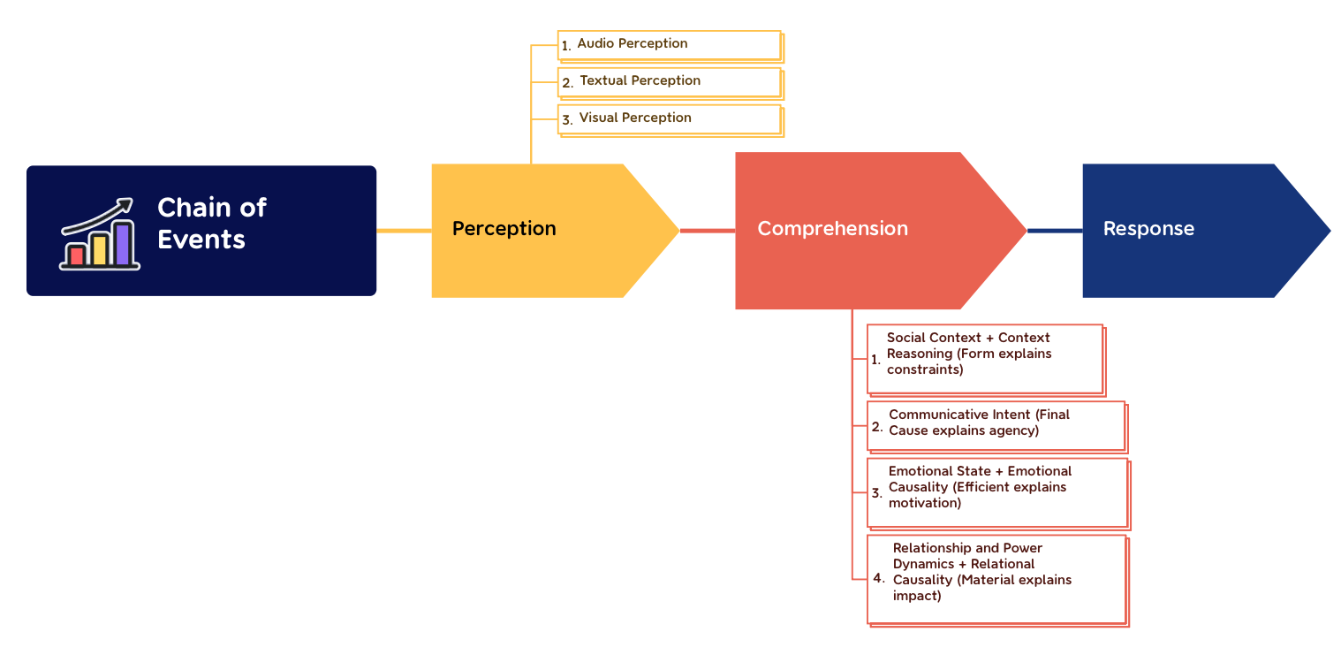

Slide 36
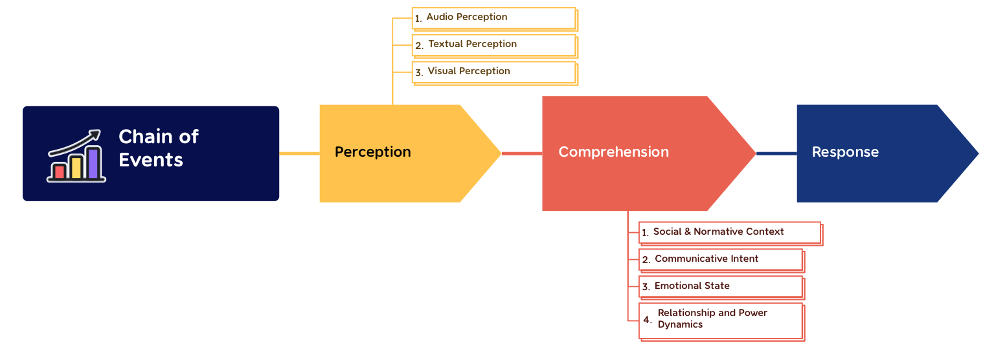

Slide 37
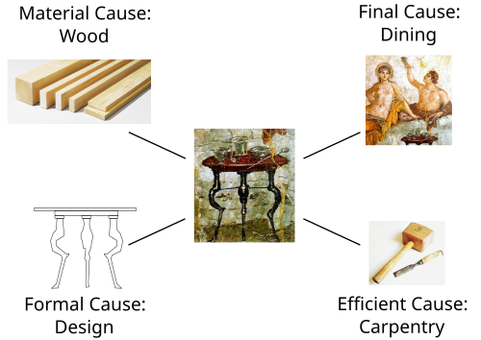
Proof of Comprehension Completeness:
Formal: The arrangement, shape, or set of rules that defines what the object is. (Normative Context)
Material: The material cause of a change or movement. (Emotions)
Efficient: The efficient or moving cause of a change or movement. (Relationships)
Final Cause: The end, goal, or purpose (Telos). Communicative Intent
Four causes by Aristotelian thought

Slide 38

Military Briefing

Slide 39
Using LangChain for Structured Outputs
{
”Comprehension": {
"1_social_normative_context": {
”Size": ”Large Group",
"permeability": "Private”,
"cultural_framework": "High Context",
"rules": [
"Silence from audience",
"Rigid attention",
"No interruption allowed"
]
},
"2_relationship_power_dynamics": {
"power_distance": "Extreme Asymmetry",
"hierarchy_type": "Formal Command Structure",
"dominance_vector": "Speaker > Audience (Absolute)",
"intimacy_level": "Professional / Distant",
"interaction_flow": "One-to-Many (Unidirectional)"
},
"3_emotional_state": {
"displayed_emotion": {
"valence": "Neutral/Serious",
"arousal": "Controlled (High Focus)",
"dominance": "High"
},
"authenticity_check": {
"status": "Masking",
"reason": "Command Presence (Suppressing vulnerability or doubt)"
}
},
"4_communicative_intent": {
"primary_category": "Regulatory",
"secondary_category": "Inspirational (Affiliative-Abstract)",
"specific_goal": "Enforce compliance and boost unit cohesion",
"illocutionary_force": "Command / Directive"
}
},
"causal_reasoning_layer": {
"emotional_causality": {
"trigger": "Mission Criticality / Duty",
"logic": "The gravity of the situation necessitates a suppression of personal emotion in favor of professional stoicism."
},
"relational_causality": {
"state_maintenance": "Reinforcement",
"logic": "The act of orating from a podium reinforces the existing hierarchy and confirms the General's status as the Efficient Cause (Leader)."
}
}
}

